Slide 1
Report authors:
Toby Heaps,
CEO of Corporate Knights
Andrew Behar,
CEO of As You Sow
Faustine Delasalle,
SYSTEMIQ Ltd., Manager of Energy Transitions Commission
2018 Q1 Update Webinar: February 15, 2018
Download the report at
www.clean200.org

Slide 2
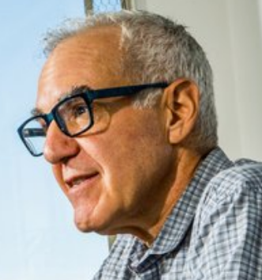
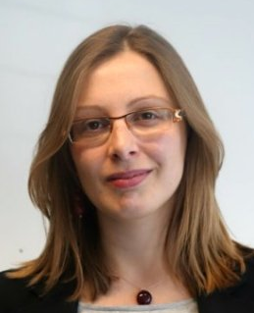
Featured Panelists
Toby Heaps,
CEO of
Corporate Knights
Andrew Behar,
CEO of
As You Sow
Faustine Delasalle,
SYSTEMIQ Ltd., Manager of Energy Transitions Commission

Slide 3
About As You Sow
Mission: to promote environmental and social corporate responsibility through shareholder advocacy, coalition building, and innovative legal strategies
Founded on the belief that many environmental and human rights issues can be resolved by increased corporate responsibility
As You Sow communicates directly with corporate executives to collaboratively develop and implement business models that reduce risk, benefit brand reputation, and protect long-term shareholder value while simultaneously bringing about positive change for the environment and human rights.

Slide 4
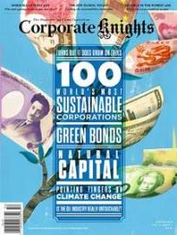
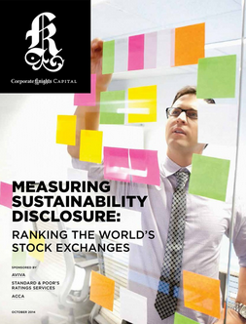
About Corporate Knights
Mission: to provide information that empowers people to harness markets for a better world
The company has a media and research division, which includes the award-winning business and society magazine Corporate Knights.
The research division produces corporate rankings, research reports and financial product ratings based on corporate sustainability performance including Cleancapitalist.com and Decarbonizer.co.
Over a decade of experience performing corporate sustainability ratings: Global 100 Most Sustainable Corporations in the World, Newsweek Green Rankings, Sustainable Stock Exchanges Ranking

Slide 5
Faustine Delasalle,
SYSTEMIQ Ltd., Manager of Energy Transitions Commission

Slide 6
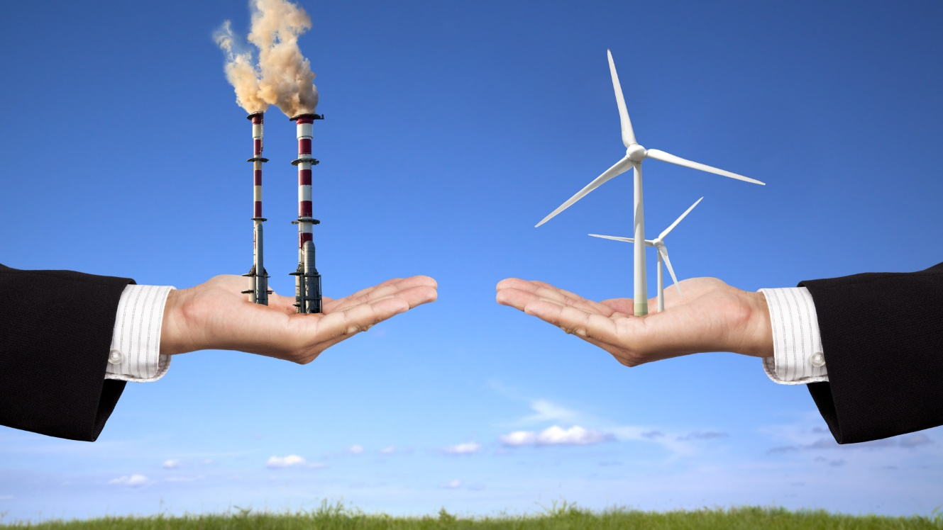
What is the Clean200TM?
The Clean200: The biggest 200 public companies ranked
by green energy revenues
And why did we create it?
Global energy system is in a monumental transition
Purpose of the Clean200 list is to start a dialogue on about:
How investors can co-create a clean energy economy
How to best evaluate & highlight companies already on the continuum of transition
Image Source: http://www.nationofchange.org/2015/06/12/ditching-fossil-fuelsnd-switching-to-100-renewables-no-problem-says-stanford-study/

Slide 7
How is the Clean200 compiled?
366 companies with more than $1b market cap and more than 10% clean energy revenues
67 company exclusions
Clean200 Negative Screens | Criteria | Number of Companies Excluded 2018
Oil and Gas | SASB SICS Sub Sector = oil & gas | 4
Coal 100 | Top 100 companies by coal reserves | 3
Non-Green Utilities | Any utility that derives less than 50% revenue from green sources | 47
Top 100 Weapons | The SIPRI Top 100 arms-producing and military services companies in the world | 4
Tropical Forest Harm | Scores less than 4 on Forest 500 scale or are on the As you Sow/Friends of the Earth Deforestation Free Funds Tool | 6
Child/Forced Labor | Scores in bottom half of Know the Chain rating | 3
Negative Climate Lobbying | Scores E or lower on Influence Map rating | 0

Slide 8
Who are the Clean200?
The top 10 Clean200 companies by revenue
Company | Clean Energy Product or Service
SIEMENS AG-REG | Renewable energies, transmission, smart grids, energy storage, public transport
TOYOTA MOTOR CORP | Hybrid, electric, fuel cell vehicles
SCHNEIDER ELECTRIC SE | Energy management
ABB LTD-REG | Renewable energies, transmission, smart grids, energy storage, public transport
PANASONIC CORP | Renewable energies and batteries
VESTAS WIND SYSTEMS A/S | Wind power
BOMBARDIER INC-B | Rail transportation
INNOGY SE | Renewable energy
SSE PLC | Wind and biomass energy
EMERSON ELECTRIC CO | Energy management

Slide 9
Who are the Clean200?
The top 10 Clean200 companies with a majority of their revenue from clean energy
Company | Clean Energy Product or Service
SCHNEIDER ELECTRIC SE | Energy management
ABB LTD-REG | Renewable energies, transmission, smart grids, energy storage, public transport
VESTAS WIND SYSTEMS A/S | Wind power
PHILIPS LIGHTING NV | LED lights
TESLA INC | Electric vehicles
OSRAM LICHT AG | LED lights
SIEMENS GAMESA RENEWABLE ENE | Wind turbines
XINJIANG GOLDWIND SCI&TECH-A | Wind plants
NORDEX SE | Wind turbines
ACUITY BRANDS INC | LED lights

Slide 10
Clean200 Sector Breakdown
Sector | # of companies
Industrials | 92
Information Technology | 43
Utilities | 24
Consumer Discretionary | 17
Materials | 16
Consumer Staples | 3
Energy | 1
Financials | 2
Health Care | 1
Telecommunication Services | 1

Slide 11
Where are
Clean200 from?
Country | # of companies
Greater China | 68
United States of America | 35
Japan | 21
Germany | 9
India | 7
South Korea | 7
Canada | 5
Sweden | 5
Denmark | 4
Ireland | 4
Spain | 4
United Kingdom | 4
Brazil | 3
Netherlands | 3
Switzerland | 3
Country | # of companies
Australia | 2
France | 2
New Zealand | 2
Thailand | 2
Austria | 1
Belgium | 1
Chile | 1
Finland | 1
Greece | 1
Italy | 1
Kuwait | 1
Mexico | 1
Country Breakdown

Slide 12
Where are
Clean200 from?
In total, European countries place a total of 43 companies in the Clean200
Country Breakdown

Slide 13
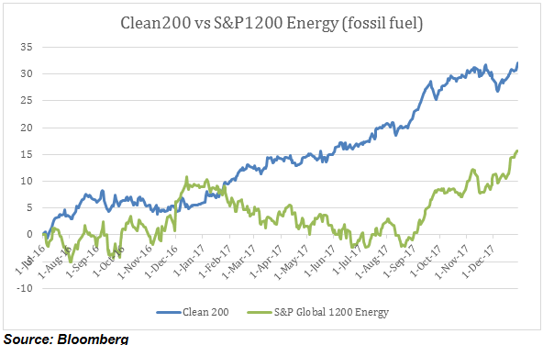
How has the
Clean200 performed?
Clean 200 new energy stocks show outperformance versus fossil fuel energy stocks (S&P Global 1200 Energy)
Financial Analysis (July 1, 2016 – December 31, 2017)
In its first full year and a half of live performance, Clean200 companies generated a total return of 32.1%--almost double the 15.7% for its fossil fuel benchmark the S&P 1200 Global Energy Index. This outperformance of clean energy over fossil fuels is notable, as it occurred over a time period that experienced a surge in oil prices.

Slide 14
New on 2018 Clean200
Company Name | Country | Clean energy product or service
Acciona | Spain | Sustainable Infrastructure and Renewable Energy
Xinte Energy Co Ltd | China | Solar energy and wind power solutions
Tianneng Power International Ltd | China | Lead-acid batteries and battery-related accessories
Avangrid | United States of America | Renewable energy
Takuma Co Ltd | Japan | Waste treatment plants, resource recovery plants, sewage disposal plants
Gibraltar Industries Inc | United States of America | Solar mounting systems

Slide 15
Was on Clean200 2017 but not in 2018 Clean200 Q1/2017
Company Name | Country | GICS sub-Industry Name | Reason
Tbea Co Ltd | China | Electrical Components & Equipment | Excluded – thermal coal mining
Senvion Sa | Luxembourg | Heavy Electrical Equipment | Under US$1bil market cap
Caverion Corp | Finland | Diversified Support Services | Under US$1bil market cap
Hanergy Thin Film Power Group | Hong Kong | Semiconductor Equipment | Under US$1bil market cap
Beijing Sifang Automation | China | Electrical Components & Equipment | Under US$1bil market cap
Veeco Instruments Inc | United States of America | Semiconductor Equipment | Under US$1bil market cap

Slide 16
Carbon Clean 200 Report
DISCLAIMER
The aggregated data comprising the Clean200™ represents a snapshot of the top-ranked “clean” companies as measured by total green energy revenue based on a methodology developed by Corporate Knights and As You Sow from data in the Bloomberg New Energy Finance database. The list should not be considered current or complete, or a substitute for financial data provided by a licensed financial advisor. Estimation methodologies are subject to limitations in modelling and measurement.
The information provided in the Clean200 and in this report is provided “AS IS” without warranty of any kind. Corporate Knights and As You Sow each makes no representations and provides no warranties regarding any information or opinions provided herein, including, but not limited to, the advisability of investing in any particular company or investment fund or other vehicle. While we have obtained information believed to be objectively reliable, neither As You Sow nor Corporate Knights, or any of each of their employees, officers, directors, trustees, or agents, shall be responsible or liable, directly or indirectly, for any damage or loss caused or alleged to be caused by or in connection with use of or reliance on any information contained herein, including, but not limited to, lost profits or punitive or consequential damages. Past performance is not indicative of future returns.
As You Sow and Corporate Knights do not provide investment, financial planning, legal or tax advice. We are neither licensed nor qualified to provide any such advice. The content of our programming, publications and presentations is provided for informational and educational purposes only, and should not be considered as information sufficient upon which to base any decisions on investing, purchases, sales, trades, or any other investment transactions. We do not express an opinion on the future or expected value of any security or other interest and do not explicitly or implicitly recommend or suggest an investment strategy of any kind.
Our events, websites, and promotional materials may contain external links to other resources, and may contain comments or statements by individuals who do not represent As You Sow or Corporate Knights. As You Sow and Corporate Knights have no control over, and assume no responsibility for, the content, privacy policies, or practices of any third party websites or services that you may access as a result of our programming. As You Sow and Corporate Knights shall not be responsible or liable, directly or indirectly, for any damage or loss caused or alleged to be caused by or in connection with use of or reliance on any such content, goods or services available on or through any such websites or services.
Copyright © 2018 As You Sow and Corporate Knights. All rights reserved.

Slide 17
Q & A with Featured Panelists
Toby Heaps,
CEO of
Corporate Knights
Andrew Behar,
CEO of
As You Sow
Faustine Delasalle,
SYSTEMIQ Ltd., Manager of Energy Transitions Commission

Slide 18
Media Contact
Cyrus Nemati
(510) 735-8157
cnemati@asyousow.org
Download the report at
www.clean200.org

Slide 19
APPENDIX A: Exclusions
Bloomberg Ticker | Company Name | Reason
6501 JP Equity | HITACHI LTD | Child/Forced labour
ADM US Equity | ARCHER-DANIELS-MIDLAND CO | Child/Forced labour
WIL SP Equity | WILMAR INTERNATIONAL LTD | Child/Forced labour
8002 JP Equity | MARUBENI CORP | Coal
991 HK Equity | DATANG INTL POWER GEN CO-H | Coal
ENEL IM Equity | ENEL SPA | Non-green Utilities
IBE SM Equity | IBERDROLA SA | Non-green Utilities
ELE SM Equity | ENDESA SA | Non-green Utilities
ELET6 BZ Equity | CENTRAIS ELETRICAS BRAS-PR B | Non-green Utilities
PCG US Equity | P G & E CORP | Non-green Utilities
NEE US Equity | NEXTERA ENERGY INC | Non-green Utilities
EIX US Equity | EDISON INTERNATIONAL | Non-green Utilities
VST US Equity | VISTRA ENERGY CORP | Non-green Utilities
XEL US Equity | XCEL ENERGY INC | Non-green Utilities
600027 CH Equity | HUADIAN POWER INTL CORP-A | Non-green Utilities
600795 CH Equity | GD POWER DEVELOPMENT CO -A | Non-green Utilities
9513 JP Equity | ELECTRIC POWER DEVELOPMENT C | Non-green Utilities
BKW SW Equity | BKW AG | Non-green Utilities
H CN Equity | HYDRO ONE LTD | Non-green Utilities
MVV1 GR Equity | MVV ENERGIE AG | Non-green Utilities
HER IM Equity | HERA SPA | Non-green Utilities
NYLD/A US Equity | NRG YIELD INC-CLASS A | Non-green Utilities
600886 CH Equity | SDIC POWER HOLDINGS CO LTD-A | Non-green Utilities
PWGR IN Equity | POWER GRID CORP OF INDIA LTD | Non-green Utilities
FORTUM FH Equity | FORTUM OYJ | Non-green Utilities
LNT US Equity | ALLIANT ENERGY CORP | Non-green Utilities
CEN NZ Equity | CONTACT ENERGY LTD | Non-green Utilities
IRE IM Equity | IREN SPA | Non-green Utilities
ACO/X CN Equity | ATCO LTD -CLASS I | Non-green Utilities
LIGT3 BZ Equity | LIGHT SA | Non-green Utilities
Bloomberg Ticker | Company Name | Reason
VER AV Equity | VERBUND AG | Non-green Utilities
ENBR3 BZ Equity | EDP - ENERGIAS DO BRASIL SA | Non-green Utilities
2380 HK Equity | CHINA POWER INTERNATIONAL | Non-green Utilities
ENA PW Equity | ENEA SA | Non-green Utilities
579 HK Equity | BEIJING JINGNENG CLEAN ENE-H | Non-green Utilities
POR US Equity | PORTLAND GENERAL ELECTRIC CO | Non-green Utilities
TA CN Equity | TRANSALTA CORP | Non-green Utilities
DIREN FP Equity | DIRECT ENERGIE | Non-green Utilities
000027 CH Equity | SHENZHEN ENERGY GROUP CO L-A | Non-green Utilities
000543 CH Equity | AN HUI WENERGY CO LTD -A | Non-green Utilities
NHPC IN Equity | NHPC LTD | Non-green Utilities
AVA US Equity | AVISTA CORP | Non-green Utilities
600863 CH Equity | INNER MONGOLIA MENGDIAN HU-A | Non-green Utilities
IDA US Equity | IDACORP INC | Non-green Utilities
NPI CN Equity | NORTHLAND POWER INC | Non-green Utilities
AQN CN Equity | ALGONQUIN POWER & UTILITIES | Non-green Utilities
000875 CH Equity | JILIN POWER SHARE CO-A | Non-green Utilities
600509 CH Equity | XINJIANG TIANFU ENERGY CO-A | Non-green Utilities
002479 CH Equity | ZHEJIANG FUCHUNJIANG ENVIR-A | Non-green Utilities
TPIPP TB Equity | TPI POLENE POWER PCL | Non-green Utilities
600868 CH Equity | GUANGDONG MEIYAN JIXIANG H-A | Non-green Utilities
NESTE FH Equity | NESTE OYJ | Oil and Gas
CZZ US Equity | COSAN LTD-CLASS A SHARES | Oil and Gas
CSAN3 BZ Equity | COSAN SA INDUSTRIA COMERCIO | Oil and Gas
ZEON US Equity | ZEONS CORP | Oil and Gas
HON US Equity | HONEYWELL INTERNATIONAL INC | Top 100 Weapons
000150 KS Equity | DOOSAN CORP | Top 100 Weapons
GKN LN Equity | GKN PLC | Top 100 Weapons
BHE IN Equity | BHARAT ELECTRONICS LTD | Top 100 Weapons
BG US Equity | BUNGE LTD | Tropical Forest Harm

Slide 20
APPENDIX A (Continued): Exclusions
Bloomberg Ticker | Company Name | Reason
WIL SP Equity | SHANGHAI ELECTRIC GRP CO L-A | Tropical Forest Harm
SIME MK Equity | SIME DARBY BERHAD | Tropical Forest Harm
GGR SP Equity | GOLDEN AGRI-RESOURCES LTD | Tropical Forest Harm
AAK SS Equity | AAK AB | Tropical Forest Harm
GDSP IN Equity | GODREJ INDUSTRIES LTD | Tropical Forest Harm
DRX LN Equity | Drax | Non-green Utilities
600089 CH Equity | TBEA | Coal

